Slide 1
U.S. Housing Market in the times of 2020
DATA 502- Data Visualization
Final Project
C. Klein

Slide 2
Table of Contents
The Story
Overview of the Data
Source
Variables / Data Types
Marks & Channels
Conclusion & Wrap-up

Slide 3
The Story – 2020 An Unpredecented Year!
A Global Health Crisis
Turned the world on its head
Overnight everything changed
Fears about economic stability and employment
Fears of sickness and death of family and friends
Crises across all industries –from food, health, banking, delivery, retail, restaurant, farming, media, supply chain….
Source:: Word Cloud Generator Based on interview with Klein family members

Slide 4
Pandemic Timeline Focus on the U.S. Housing Market
Jan 2020: Reports of viral pneumonia - CDC
No impact to Housing
Home prices & Sales are up
Feb 2020: Reports are growing: Novel coronavirus. US Alerted.
Open House attendance begins to drop
Mar 2020: US call to action. Stay home orders. Life changes
Open Houses cancelled
April & May 2020: First Peak pandemic – mass hospitalizations, high infection & mortality rates
Housing Industry is frozen

Slide 5
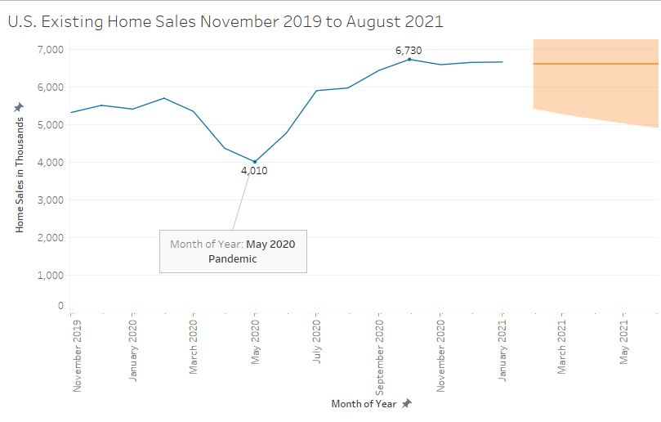
2020 has been a rollercoaster
U.S. Existing Home sales began to fall in March
Reaching 4020K at its lowest point in May which coincided with the 1st peak of covid-19 cases
But then, Existing Home sales started to pick up

Slide 6
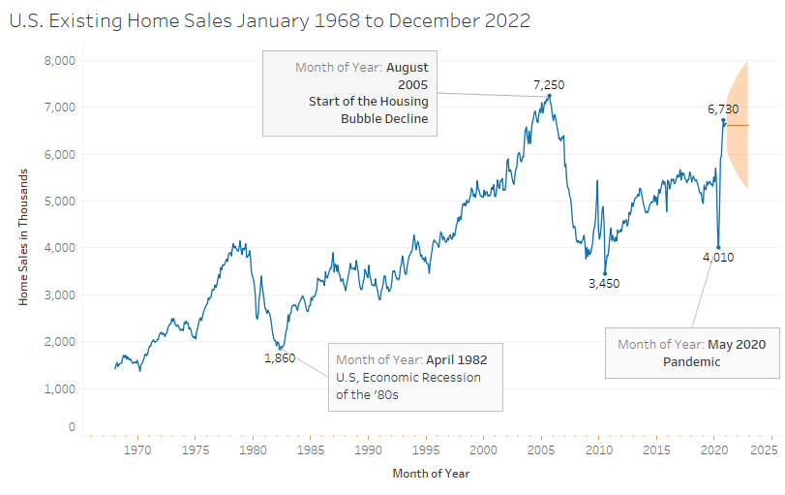
Notes:
Sales of existing homes in the US screeched to a halt

Slide 7
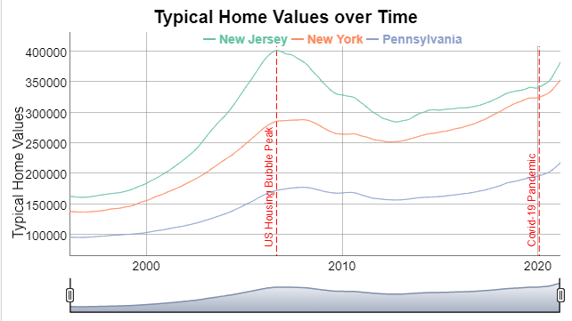
What about U.S. Home Values?
Home prices have been on the rise since middle of 2010.
We can see the steep incline in 2020. about +10% rate of change from Jan 2020.

Slide 8
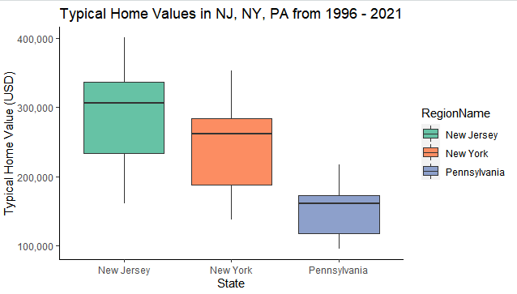
NJ, NY, and PA Home prices

Slide 9
Curious about how NJ, NY, & PA compares to the country and NYC metro areas?
Source: Zillow Housing Data. https://www.zillow.com/home-values/

Slide 10
How did Mortgage Rates compare to Existing Home Sales?

Slide 12
What about mortgage rates and home prices in NJ , NY, and PA ?

Slide 14
Overview of the Data
Muliple Sources:
Home Price Data – Zillow - Zillow Home Value Index
RegionName – Categorical
X1996.01.31 – X2021-02-28: Quantitive, Continuous
Melted Columns names and converted in Date
Average Days on Market – Zillow
RegionName – Categorical
Value: quantitative, discrete
Mortgage Rate Data – Freddie Mac – Primary Mortgage Market Survey
Daye - Dates, Ordered, Categorical
30-Yr-Fixed-Rate – Quantitative, continuous
15-Yr-Fixed Rate – Quantitative, continuous
United States Existing Home Sales 1968-2021 Data – Trading Economics
Country – Categorical
Category – Categorical
DateTime; - Date, ordered, categorical
Value;Quantitative, discrete
Frequency;categorical

Slide 15
Marks & Channels
Marks: Lines
Channels:
Color: 2 Hue – Categorical – Representing Existing home sales Actual in Blue and Forecasted in Orange
Horizontal Positioning – Categorical – ordered – Year
Vertical Positioning – Quantitative representing home sales
Data Point Labels – showing points of interest and providing further details.
Logic:
Line graph was the best way to depict time series data showing dips and peaks (TABLEAU) Filtered by Date Range

Slide 16
Marks and Channels
Marks: Lines
Channels:
Color: Hue – Categorical representing States
Horizontal positioning representing categorical ordered date
Vertical positioning representing quantitative discrete typical home values
Point of interests were annotated and marked with dotted vertical lines
Logic :
Used Dygraph Time Series Line graph in R – Line graph worked to depict 3 series on a single axis with Date Range selector widget for interactivity

Slide 17
Marks and Channels
Marks: Lines, Area
Channels:
Color: Hue representing categorical states
Horizontal positioning – categorical states
Vertical positioning representing quantitative , continuous values
Length: representing range of quantitative values
Area: representing statistical analysis of the quantitative values
Logic:
I wanted to show a comparison of the homogeneity and range of the home prices of the 3 different state
Boxplot in R

Slide 18
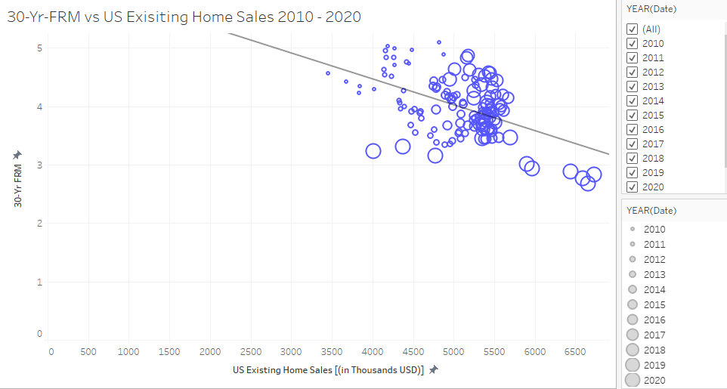
Marks and Channels
Marks: Points
Channels:
Color: 1 Hue – Categorical
Size of Point: categorical, ordered Year
Vertical positioning : representing quantitative, continuous values – fixed rates
Horizontal positioning- representing quantitative, continuous values – existing home sales
Logic:
Used scatterplot to show relationship between 2 variables. Also, wanted to distinguish the point by year
Tableau

Slide 19
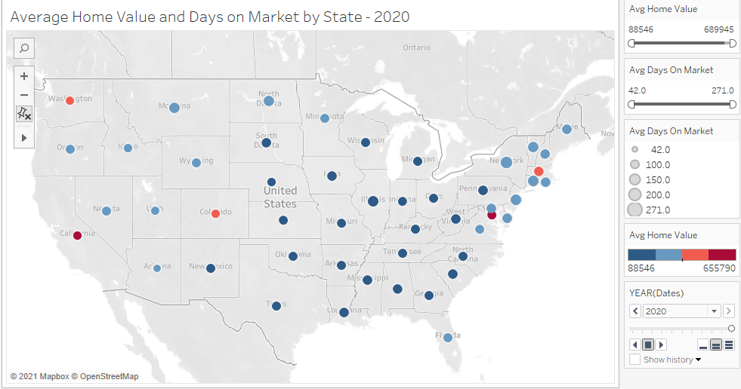
Marks and Channels
Marks: Points
Channels:
Hue: depicting home values in ranges: categorical, ordered
Size: depicting quantitative, discrete number of days on market value
Spatial positioning depicting categorical variable of State
(Animation: shows the change in home prices and days on the market by year)
Logic
Geographic Map was the best way to compare the home values and days on the market for all states. Filters on Home prices, Days on the market, animation of time - Tableau

Slide 20
Marks and Channels
Marks: Lines
Channels:
Hue: depicting quantitative variables
Length: depicting quantitative, discrete number sales of existing homes (bar chart)
Horizontal positioning depicting ordered categorical variable Date (Both Bar & lines)
Vertical positioning depicting quantitative values of rates (lines)
Logic
Combo chart showing existing home sales alongside mortgage rate adjustments for the same time period

Slide 21
Marks and Channels
Marks: Lines
Channels:
Hue: depicting quantitative variables states and rates
Length: depicting quantitative, discrete home prices (bar chart)
Horizontal positioning depicting ordered categorical variable Date (Both Bar & lines)
Vertical positioning depicting quantitative values of rates (lines)
Logic
Combo chart showing home values alongside mortgage rate adjustments for the same time period

Slide 22
Conclusion & Wrap Up
The events of 2020 had direct impact on the U.S. Housing Market. Existing Home Sales dropped and rebounded within 6 months with latest sales approaching the Housing bubble of mid-2010s level despite the market coming to a near halt in May 2020.
Low mortgage rates and other factors may have helped spur the rebound of existing home sales
Home prices continues to rise and after 2020 and the average rate of change is 10% over the previous year for NJ, NY, and PA.
Since 2010, the average days that homes have stayed on the market has overall decreased. Home prices in states like California, Massachusetts, Washington, D.C, Colorado are the highest compared to other US states in 2020

Slide 23
About Me
This presentation is also posted on my website.
http://www.claudiakleinonline.com

